Slide 1
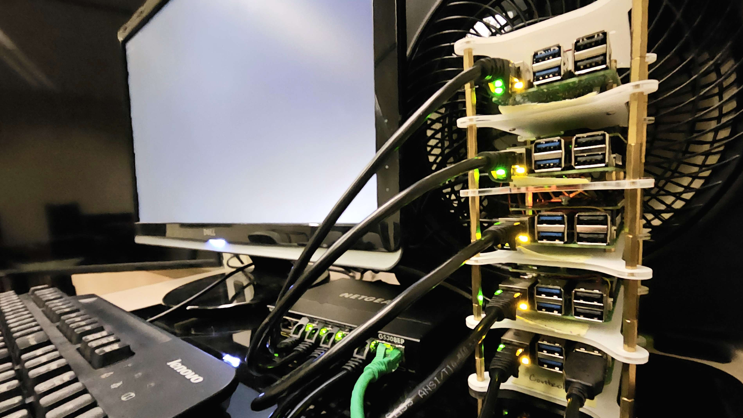
ClusterGit
Team #12:
Conner | Lauren | Sasha | Sean | Brandon

Slide 2

What to Expect
Problem Statement & Requirements
Use Cases
Risks
Tasks Accomplished
Demo: Monitoring
Cluster & System Models
Next Steps

Slide 3
Problem
To Solve

Slide 4


Problem Statement
Large file storage is not natively offered by tools like Github. This creates a problem when using these platforms for version control of projects that have larger file sizes.
Notes:
Sasha

Slide 5

Functional
Nonfunctional
Registration and Authentication
Repository Management
Large File & Encrypted File Support
Removal of aged repos
Storage
Security
Efficiency & Performance
Availability
Usability
Notes:
Sasha

Slide 6
Use-Cases

Slide 7
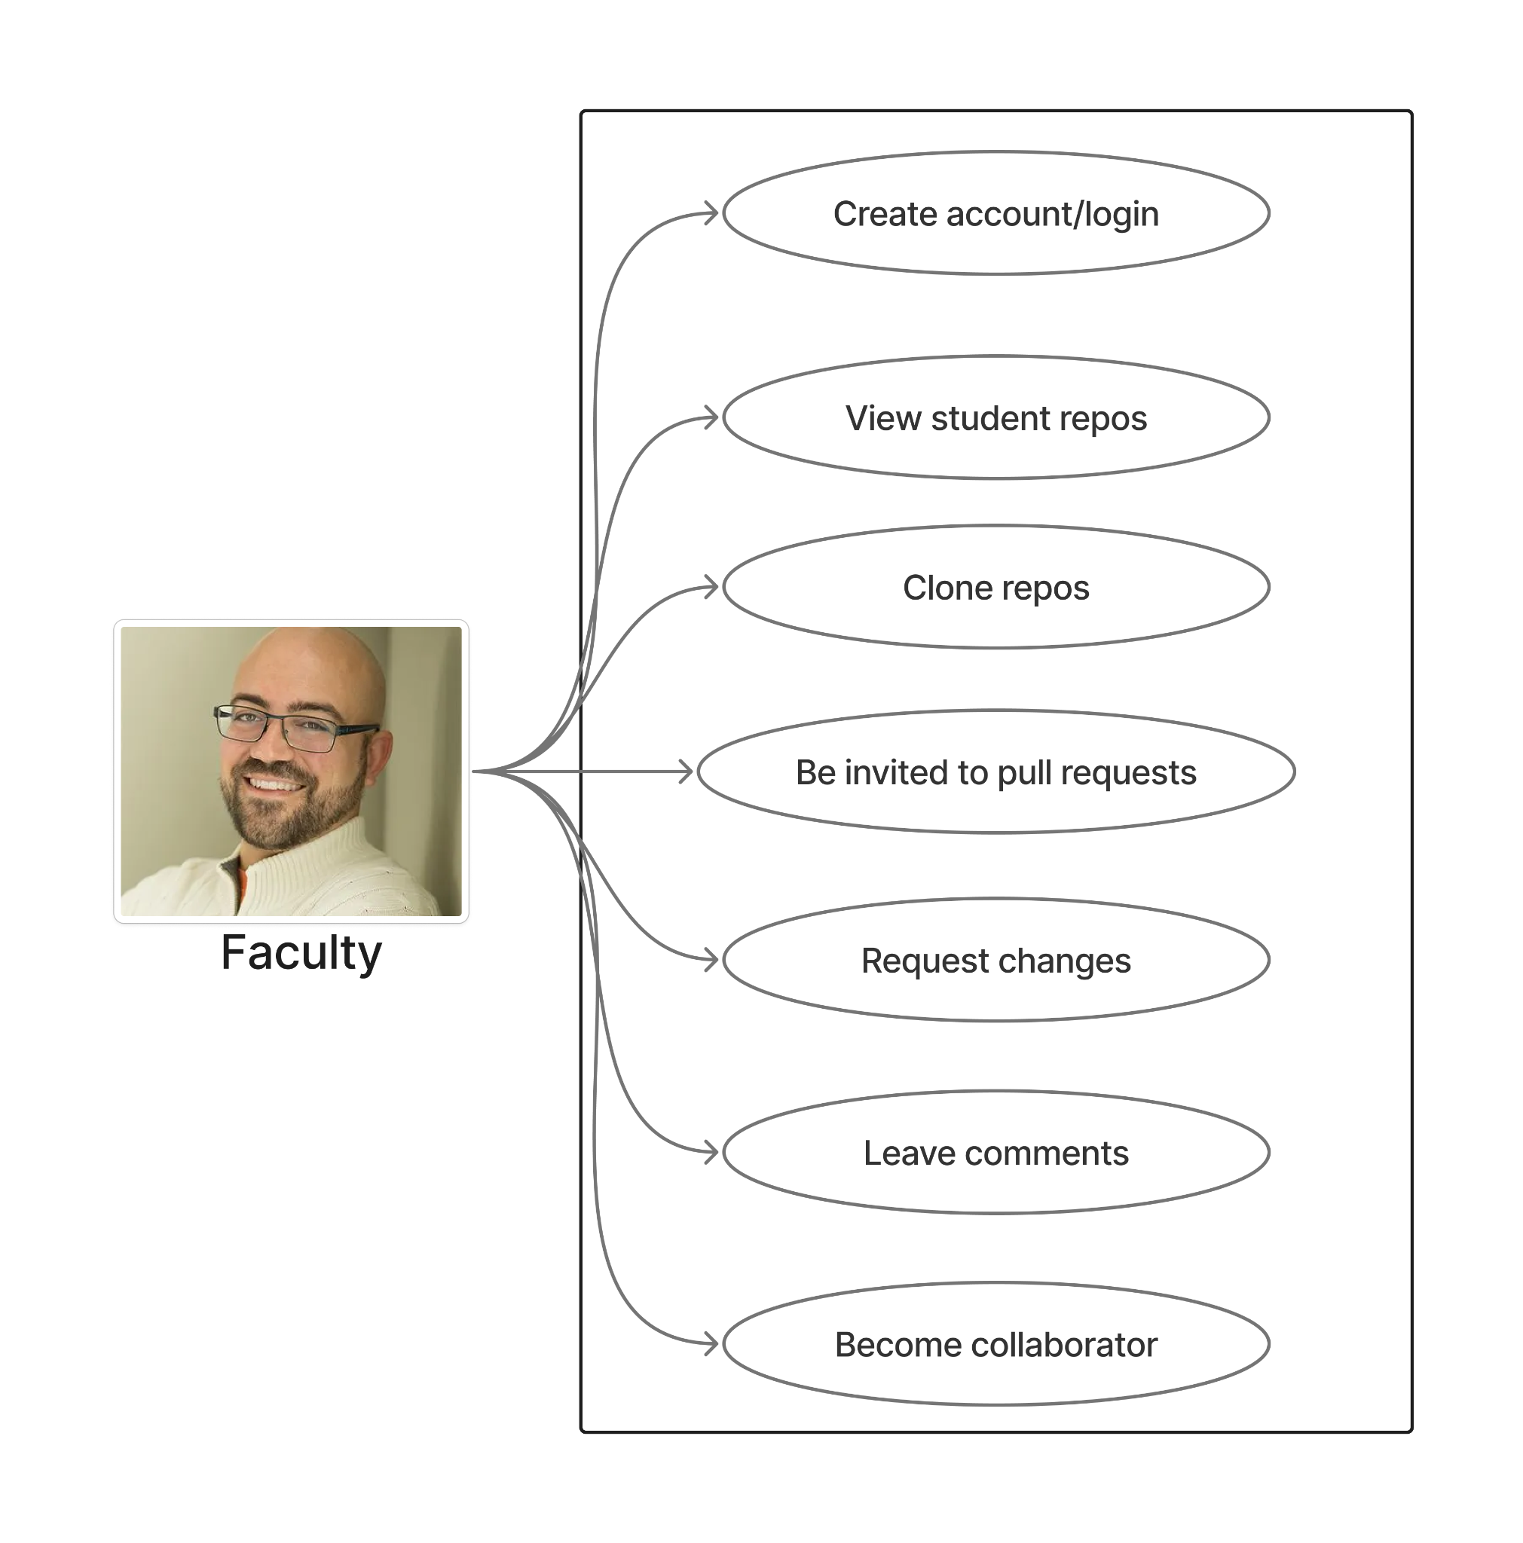
Notes:
Sasha

Slide 8
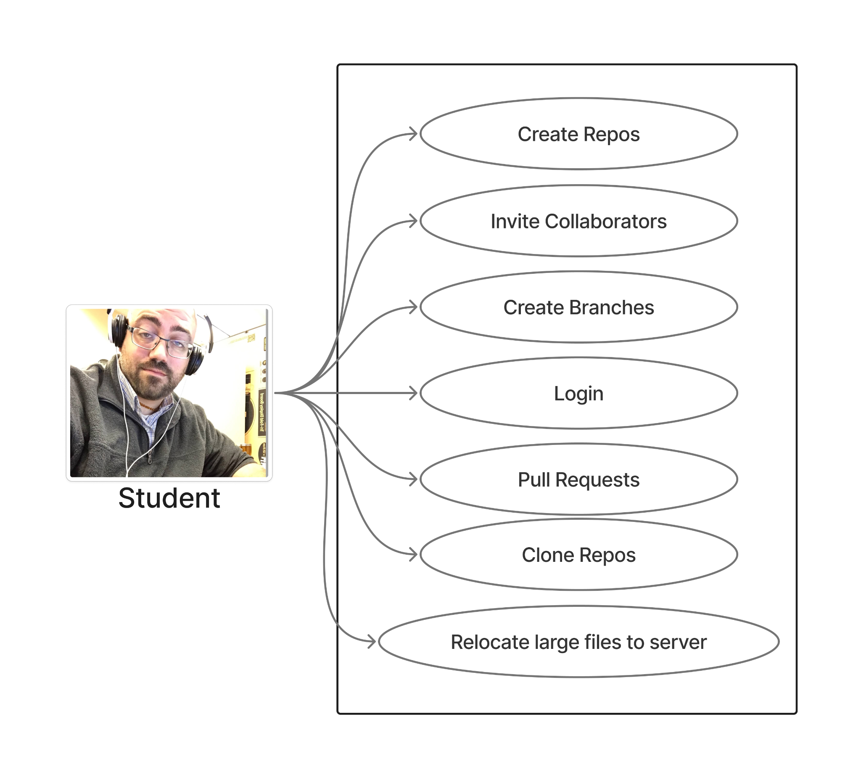

Slide 9
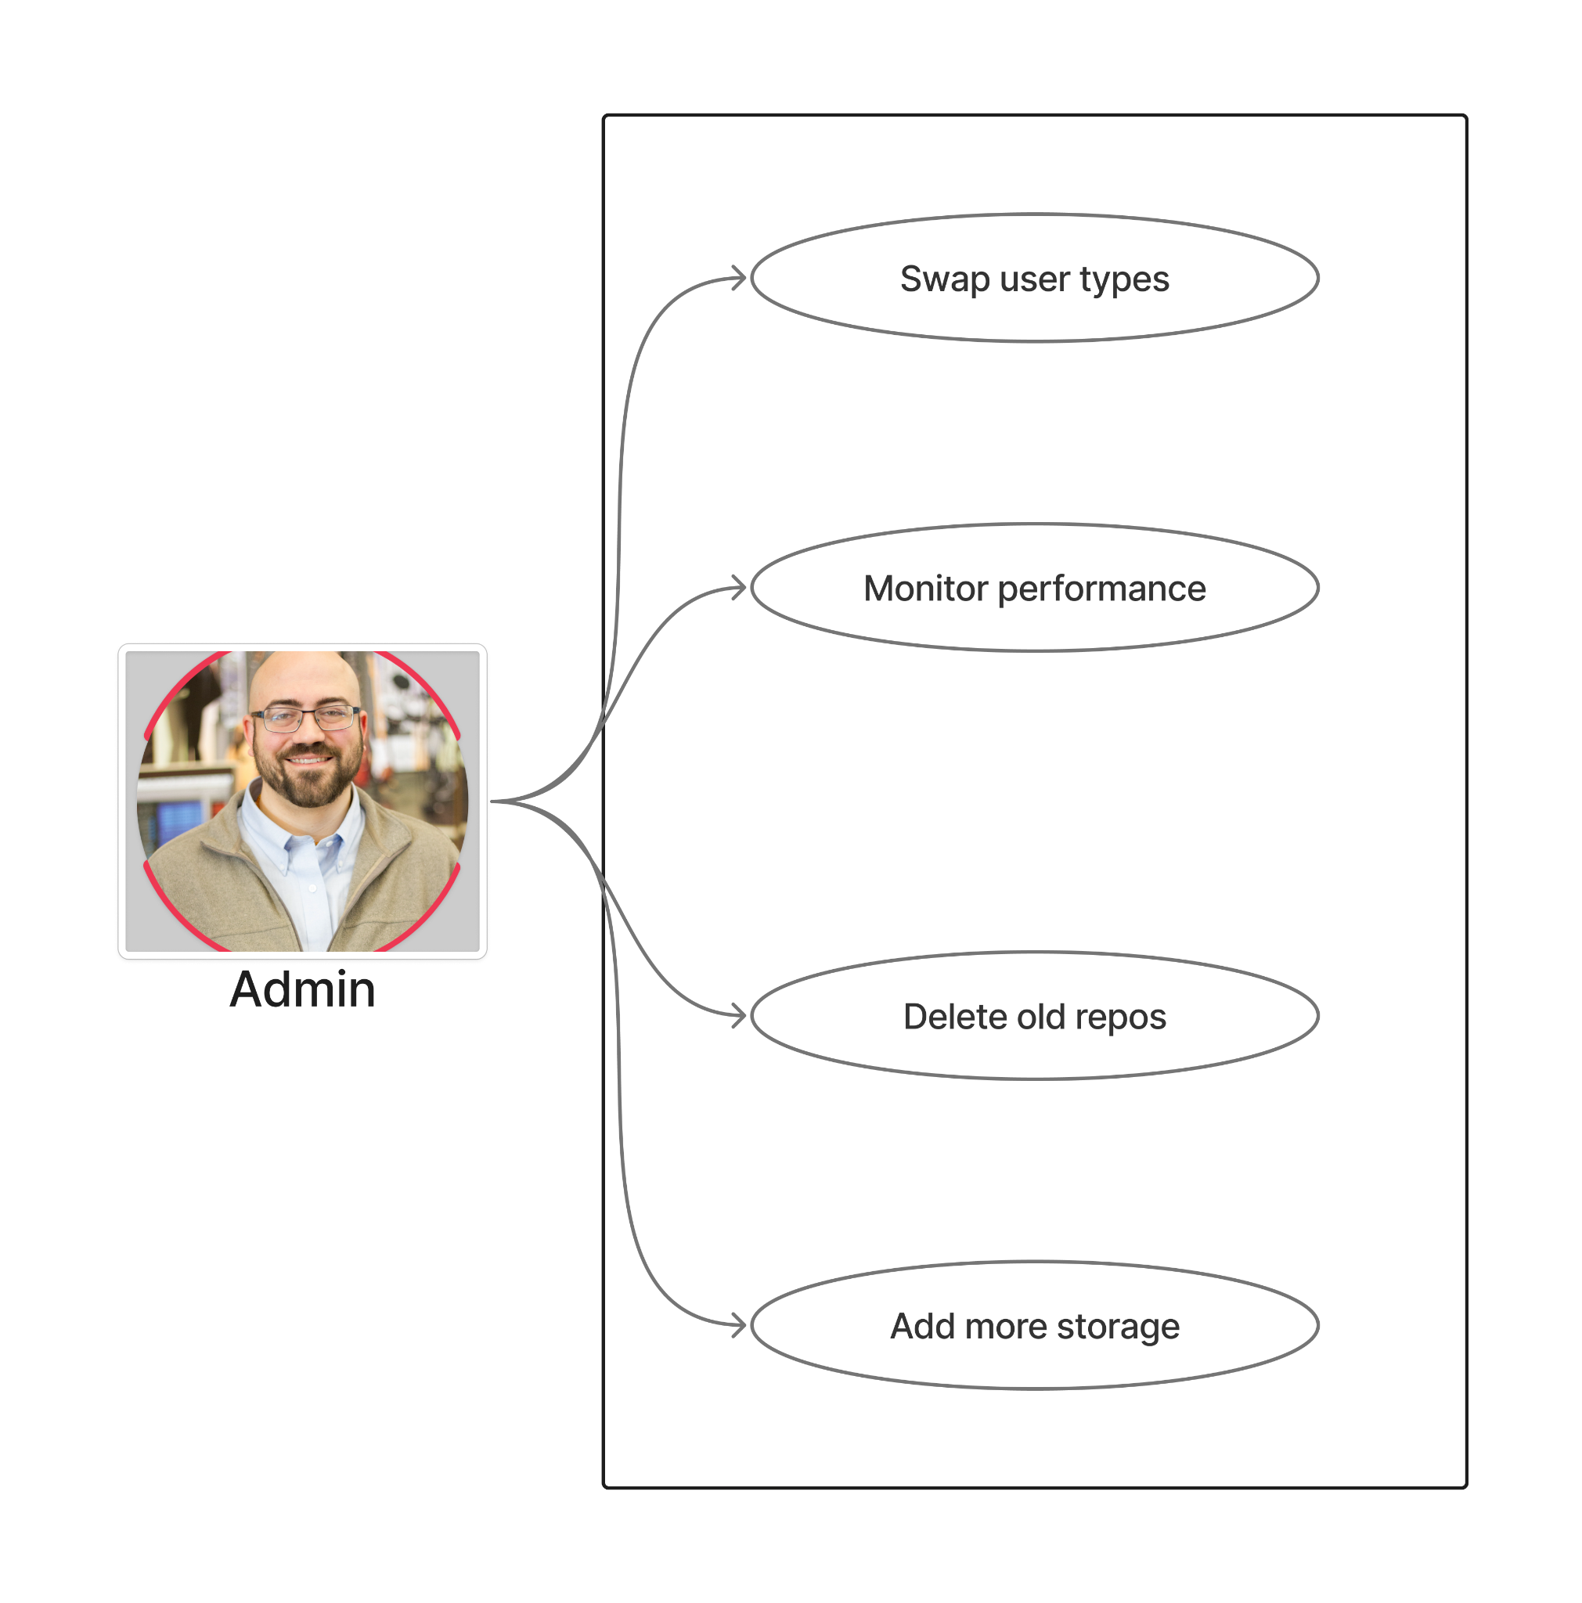

Slide 10
Risks & Accomplishments

Slide 11

Risks
Network Access
Overheating
Hardware Failure
Storage Bottleneck
Integration Risks
Scheduling and Lab Access
Scope Creep
Notes:
Brandon

Slide 12
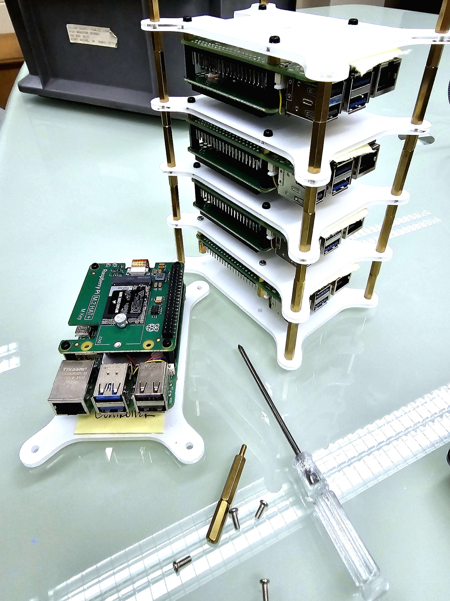
Tasks Accomplished
Built the cluster
Last Sprint User Stories:
Admin:
remotely access the server
Admin:
monitor the servers using a dashboard
Notes:
Brandon

Slide 13
DEMO

Slide 14
Models

Slide 15
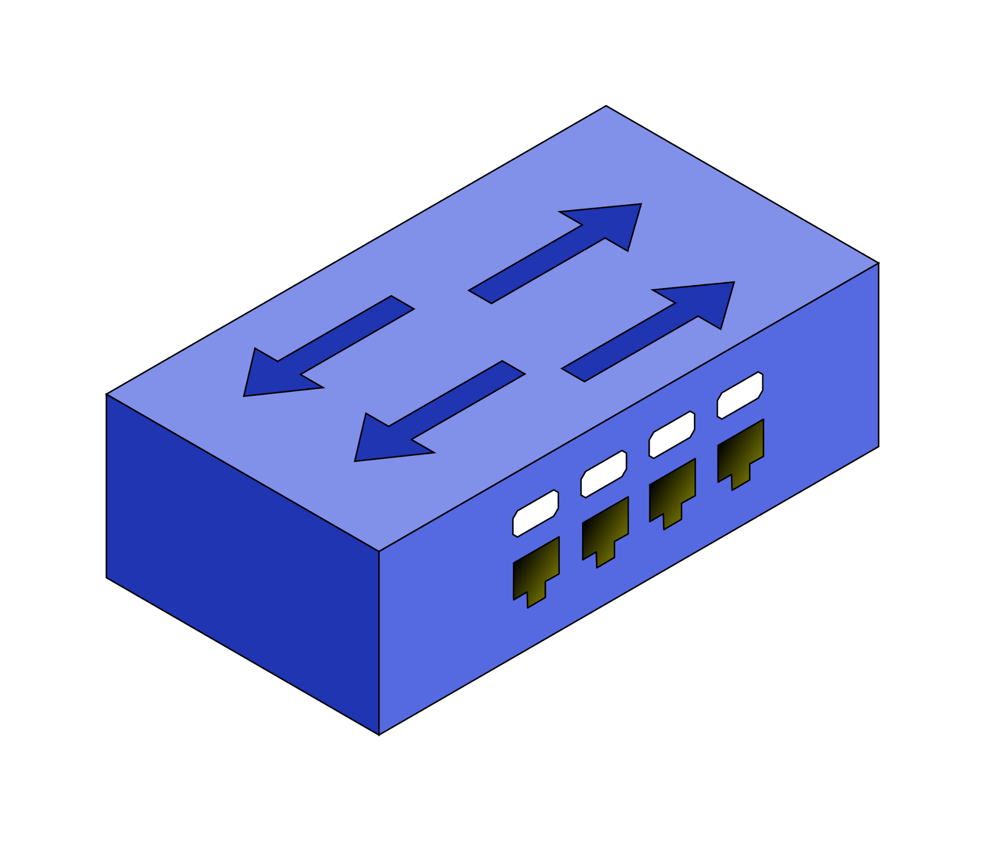

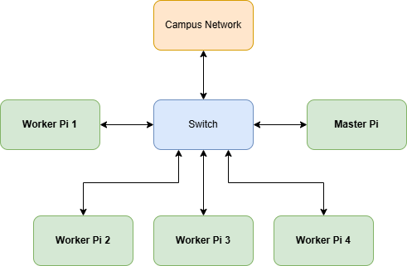
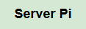
Cluster Model
Notes:
Sean
TODO: Change master to controller

Slide 16
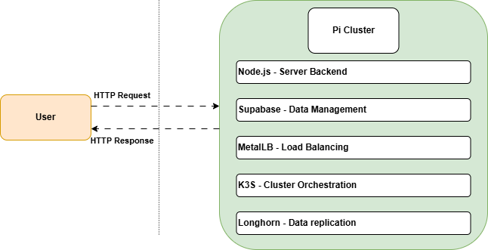
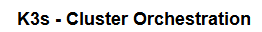
System Model
Notes:
Sean
Note- Get rid of MetalLB and add in the built in k3s loadbalancer

Slide 17
Plan

Slide 18

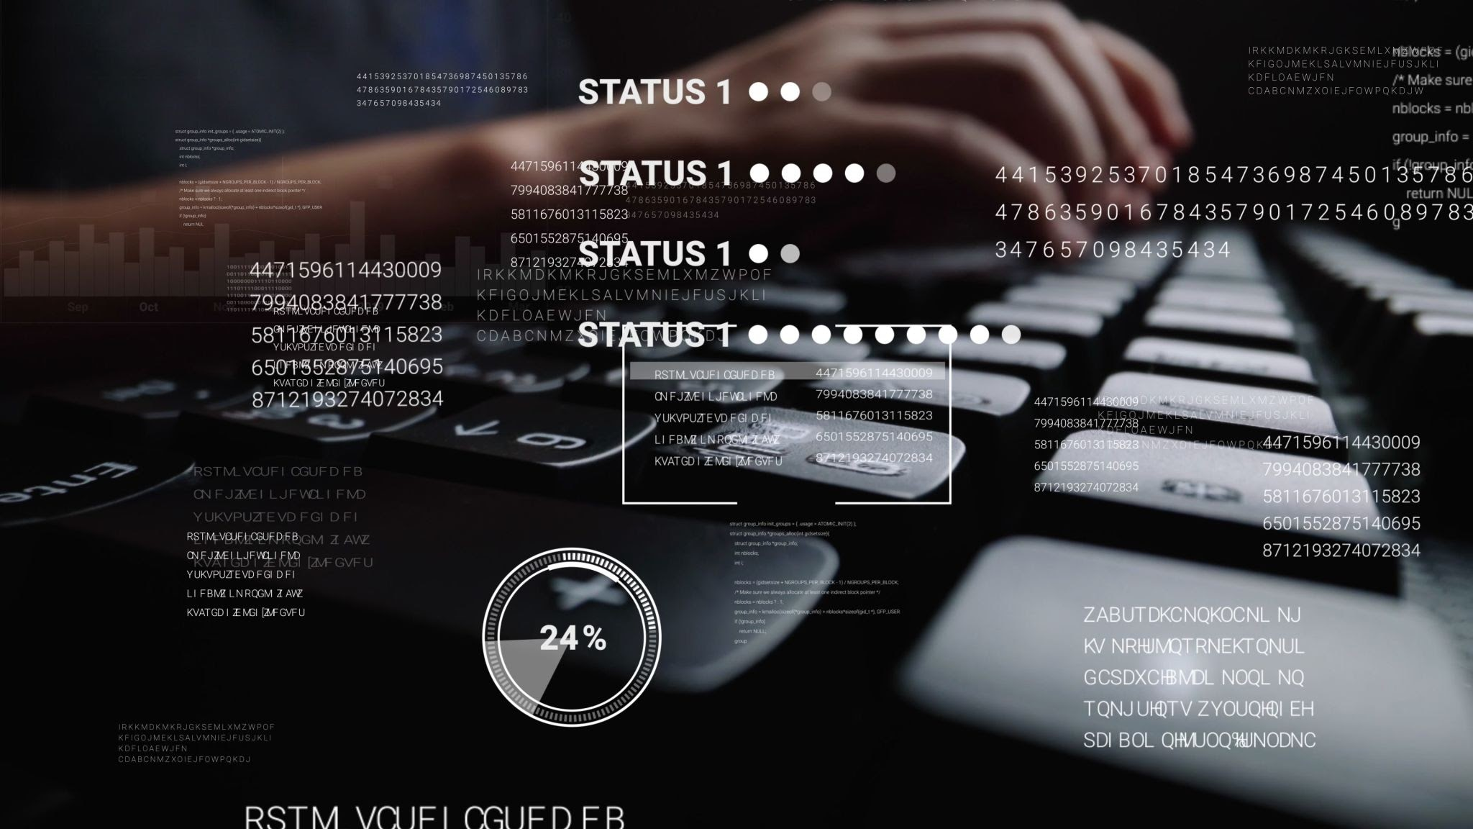

Project Plan
Upcoming Sprint
Student:
create repositories to submit
my assignments
CLI
Layering Git-annex
Encryption
Extend and
Link Database
Notes:
Conner Note: User Statements = Sprints; Layers = git, git-annex (configure Longhorn)

Slide 19

What We Covered
Problem Statement & Requirements
Use Cases
Risks
Tasks Accomplished
Demo
Cluster & System Models
Next Steps
Notes:
Conner - Large Game files, faculty student admin use cases, hardware failure, we built the cluster, System models, and next steps

Slide 20
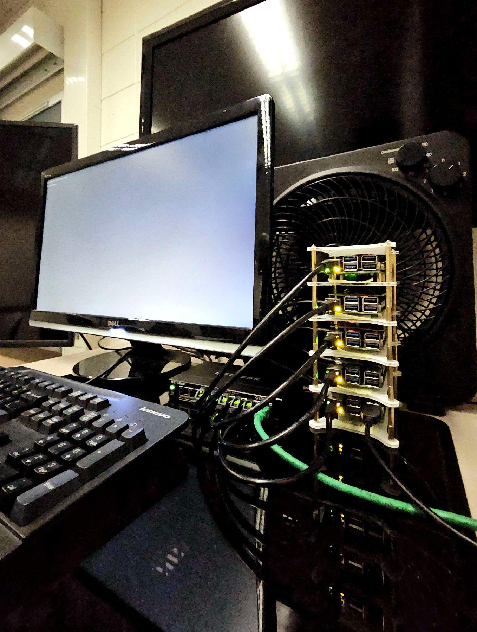

Thank You! 🎆
Questions?
Notes:
Conner i think

